Slide 1
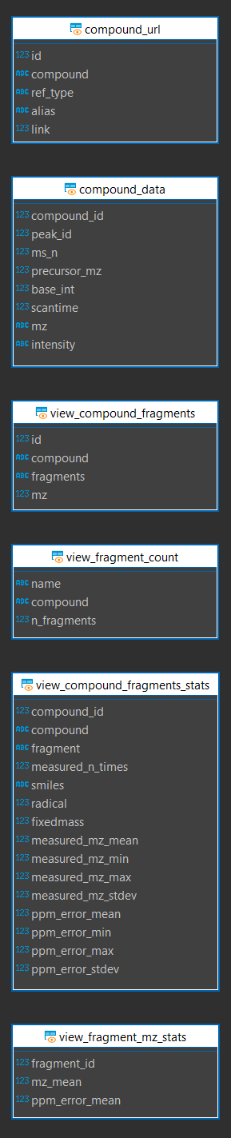
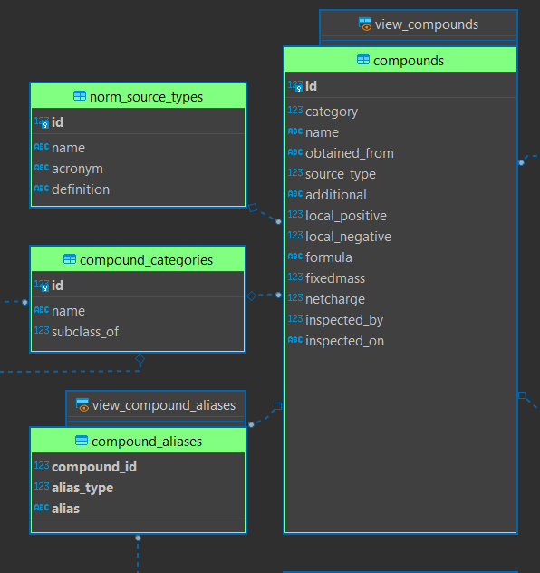
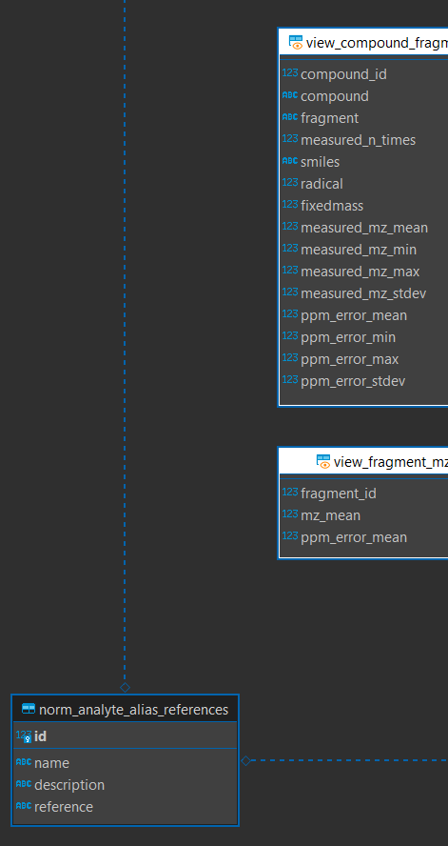
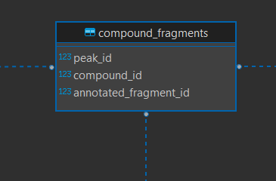
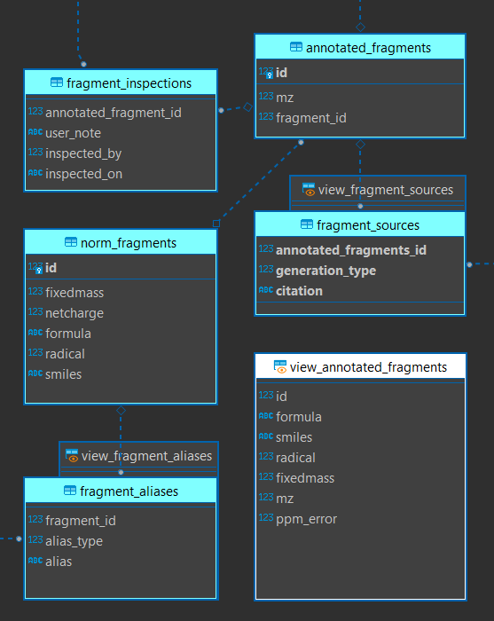
Analyte Node
[ Contributors Node ]
[ Data Node ] →

Slide 2
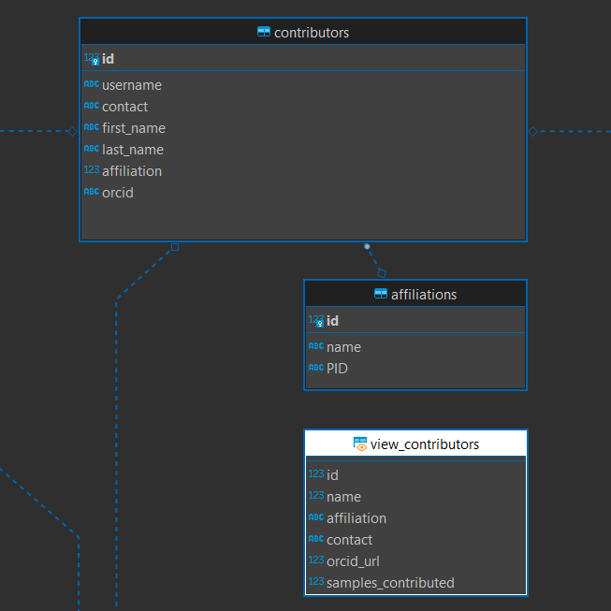
<- [ Analyte Node (compounds) ]
Contributors Node
[ Samples Node ] ->
[ Analyte Node (fragments) ]
|
V

Slide 3
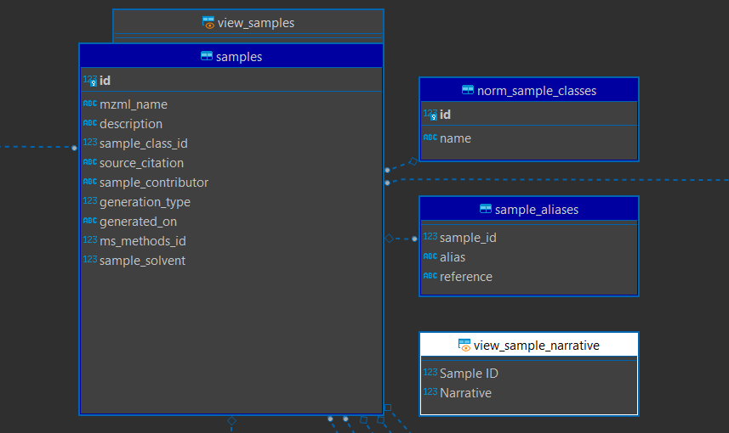
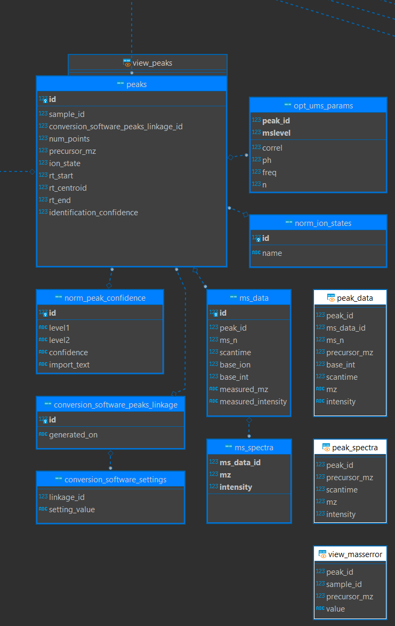
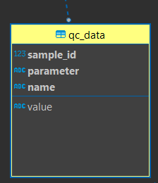
[ Methods Node (ms methods) ] ->
Data Node
<- [ Contributors Node ]
<- [ Analyte Node ]
[ Methods Node (QC) ] ->
[ Methods Node (chromatography) ] ->

Slide 4
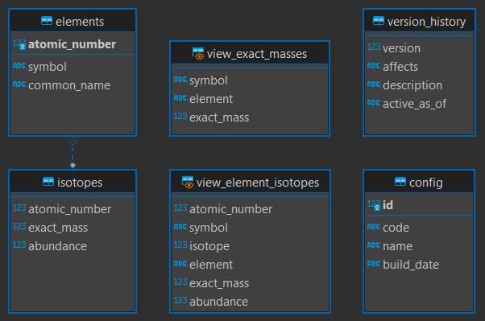
Reference Node

Slide 5
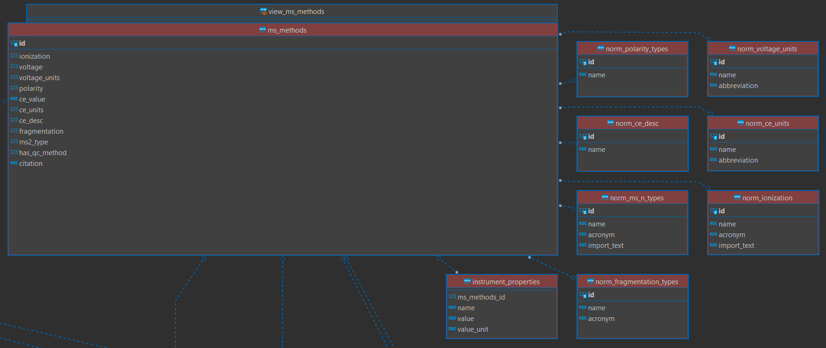
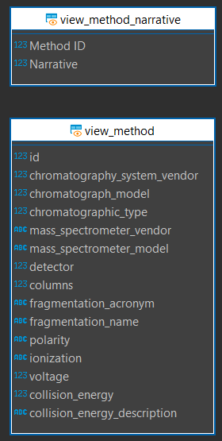

Methods Node (mass spec)
<- [ Samples Node ]
[ Methods Node (QC) ]
[ Methods Node (mobile phase) ]
[ Methods Node (descriptions) ]

Slide 6
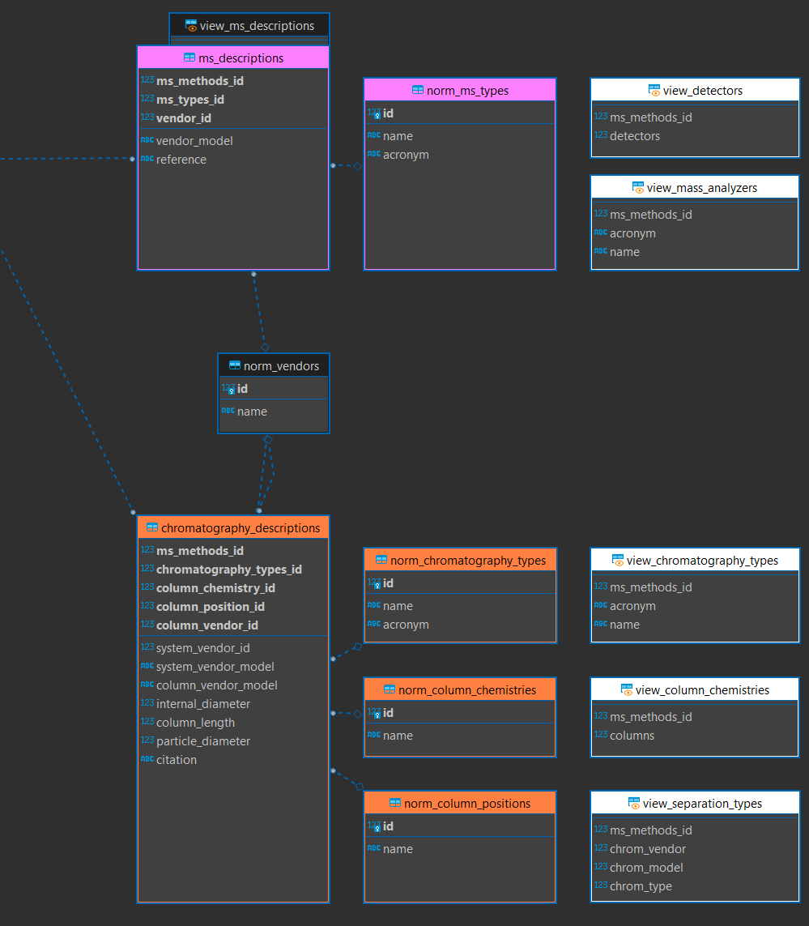
[ Methods Node (mass spec) ]
Methods Node (descriptions)

Slide 7
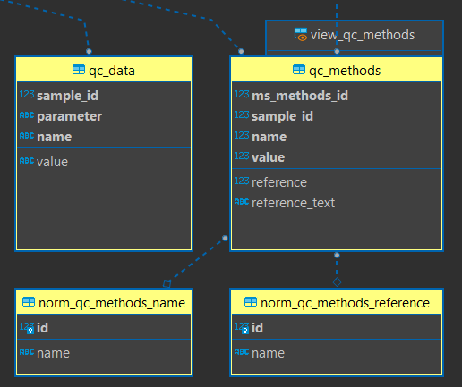
Methods Node (QC)
[ Methods Node (mass spec) ]
<- [ Samples Node ]

Slide 8
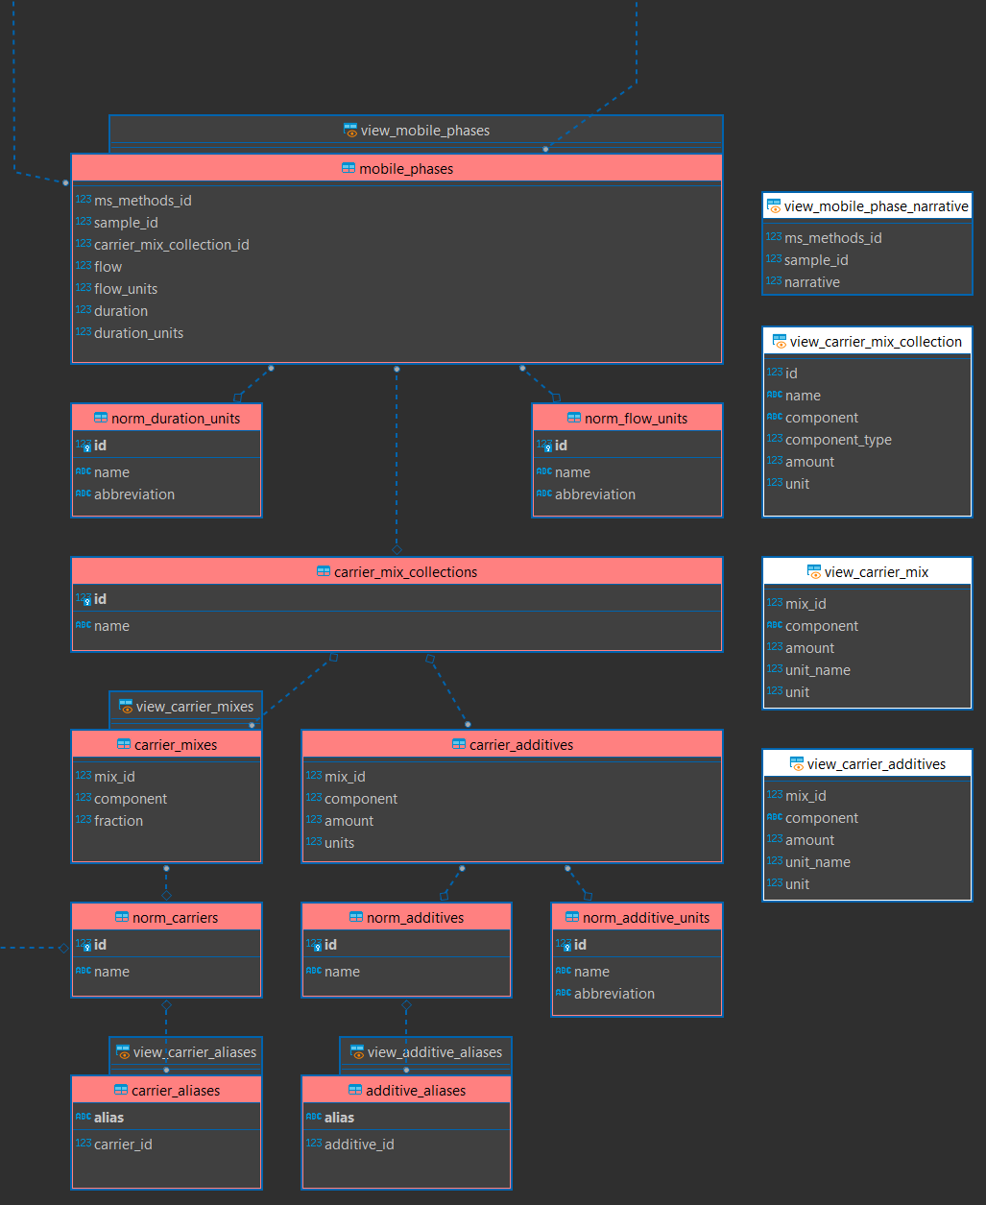
[ Methods Node (mass spec) ]
[ Samples Node ]
Methods Node (mobile phase)

